Slide 1

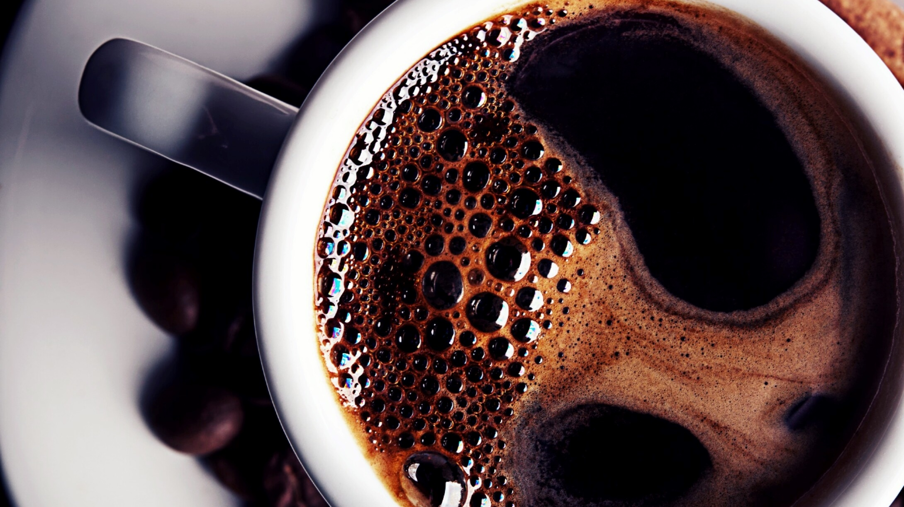
Monday Coffee Expansion Analysis
By vidhi tyagi

Slide 2
Business Objective
Expand by opening 3 coffee shops in top Indian cities
01
Use historical online sales data (since Jan 2023)
02
Recommend best cities based on data-driven insights
03

Slide 3
Business Questions Covered
To select the best cities, I analyzed:
  •Market size (coffee consumers)
  •Revenue performance
  •Product demand
  •Customer strength
  •Profitability vs rent
  •Growth trends

Slide 4
Coffee Consumers per City
Question
How many people in each city are likely to consume coffee?
Logic
Assumed 25% of city population consumes coffee
SQL Insight
population * 0.25
Why I did this
Larger coffee-drinking population = bigger future demand
Outcome
Identified cities with highest market potential

Slide 5
Revenue Analysis (Demand Strength)
Question
What is the total revenue generated in Q4 2023?
  Reflects recent & stable demand
  Avoids early-stage launch bias
What I found
Cities with consistently high revenue contribution
Business Insight
High revenue cities are safer for physical expansion

Slide 6
Product Sales Performance
Question
How many units of each product were sold?
Why
  Helps understand customer preferences
  Useful for inventory & menu planning
Outcome
  Identified best-selling products
  Helped analyze product demand across cities

Slide 7
Average Sales per Customer (Profitability) ⭐
Question
What is the average sales amount per customer in each city?
Why this matters
  High total sales ≠ high profitability
  Avg spend per customer shows true value
Metric Used
  Avg Sales per Customer = Total Sales / Unique Customers
Insight
Cities with higher per-customer spend are more profitable

Slide 8
City Population vs Actual Customers
Question
Compare estimated coffee consumers with current customers
Why
  Shows untapped market opportunity
  Helps identify growth potential
Outcome
Cities with large gap = strong expansion opportunity

Slide 9
Top 3 Products per City
Question
What are the top 3 selling products in each city?
SQL Technique Used
DENSE_RANK() window function
Why
  Helps customize store-level product strategy
  Avoids one-size-fits-all approach
Outcome
City-specific product insights

Slide 10
Customer Base Strength
Question
  How many unique customers exist in each city?
Why
  Strong customer base = lower risk
  Indicates brand acceptance
Outcome
Cities with loyal & recurring customers ranked higher

Slide 11
Average Sale vs Rent (Cost Analysis) 🔥
Question
Compare average sales per customer with rent per customer
Why this is critical
  High sales + high rent ≠ profit
  Expansion must be financially sustainable
Key Metric
  Avg Rent per Customer = Estimated Rent / Total Customers
Insight
Cities with low rent & high spend are ideal

Slide 12
Monthly Sales Growth Analysis
Question
How are sales growing month-over-month?
SQL Concepts Used
  LAG()
  Window functions
  Time-based analysis
Why
Growth trend > one-time high sales
Outcome
Identified stable & growing cities

Slide 13
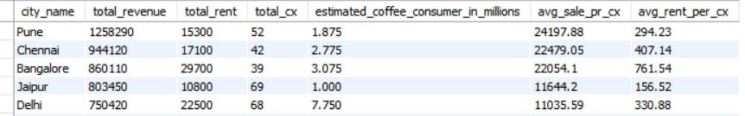
Final Market Potential Analysis
Combined Metrics Used
  Total revenue
  Avg sales per customer
  Total customers
  Estimated coffee consumers
  Rent impact
Why combined approach
  Prevents biased decision
  Balanced risk vs reward

Slide 14
Final Recommendation – Top 3 Cities
  •Pune
  •Jaipur
  •Delhi
Final Selection Based On
High revenue
Strong customer base
High per-customer spend
Sustainable rent
Positive growth trend
Business Impact
Data-driven expansion
Reduced financial risk
Higher success probability

